Slide 1
Transit Forecasting Accuracy: 142 Projects 5 Decades
David Schmitt, AICP
“Project Forecasting Accuracy” workshop at the 2019 TRB Planning Applications Conference
June 5th, 2019
Notes:
Good afternoon everyone! This presentation reflects some personal work on transit forecasting accuracy that I've been doing for about 6 years now. Please be aware this material focuses on ridership forecasts, not cost or other types of forecasts for the project.

Slide 2
About the Transit Forecasting Database (1)
Personal effort that builds upon – but not related to – Federal Transit Administration’s Predicted vs. Actual Studies and Before and After Studies
Other data sources (all publicly-available):
Transportation Investment Generating Economic Recovery (TIGER) proposals
Better Utilizing Investments to Leverage Development (BUILD) grant proposals
Academic and practitioner forecasting accuracy reports
News articles
Transit agency websites
Transit-related websites
Data fields:
Project-related characteristic
Forecast inputs & exogenous forecasts
Forecast & actual ridership
Notes:
What I call the Transit Forecasting Accuracy Database started with aggregating the forecasting data from FTA's studies. Then I added many other projects by collecting information from a variety of publicly-available sources. The database includes information about the forecast, and also characteristics of the project, including its length, mode and other details. So...(go to next slide)

Slide 3
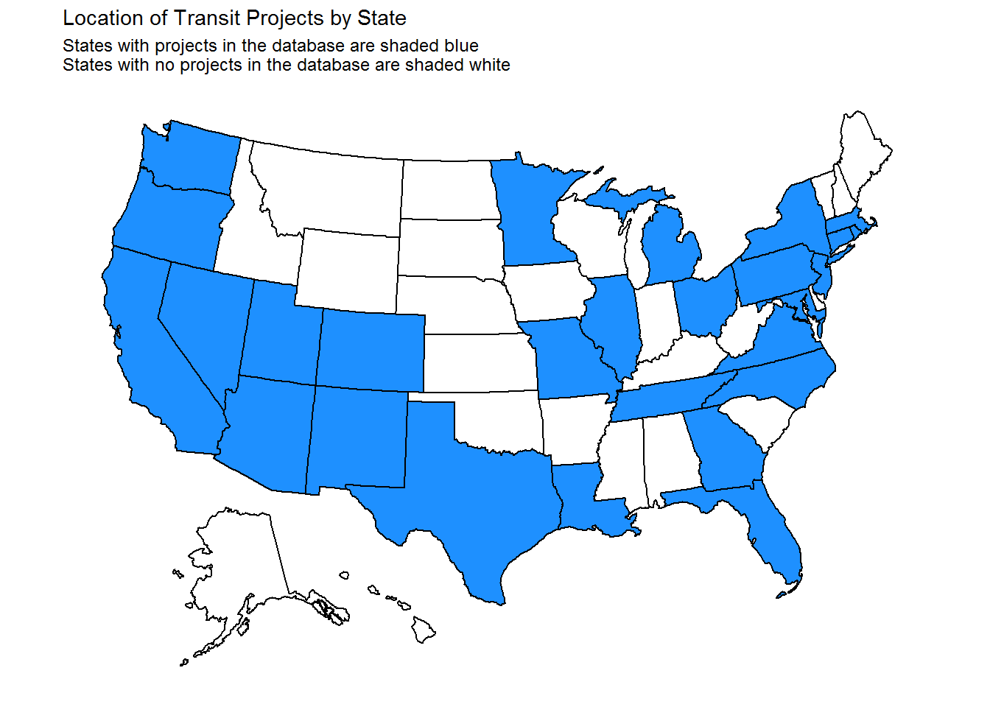
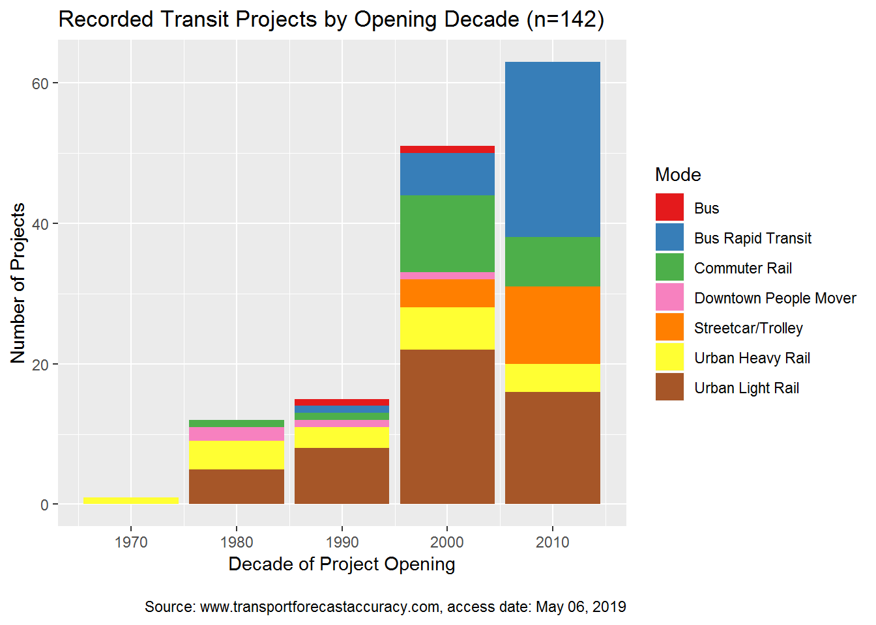
About the Transit Forecasting Database (2)
142 projects from 29 states, 5 decades
279 forecasts (~2 per project)
417 observations of actual ridership (~3 per project)
Notes:
...by the end of 2018 the database has information on the ridership forecast accuracy of 140 projects across 5 decades - dating back to the 1970s and 1980s. 29 states are represented, with virtually every surface mode. The chart on the right gives you a sense of the number of projects by decade and mode.

Slide 4
Measuring Forecast Accuracy
$$Accuracy Ratio= \frac{Actual Value}{Forecasted Value}$$
Strongly over-forecasted
Generally accurate
Strongly under-forecasted
Perfect Forecast
Note: the results presented here reflect a comparison of each project’s most recent forecast and the closest observation year of actual ridership
Notes:
The primary metric I use to define accuracy is what's called the accuracy ratio: actual ridership divided by forecasted ridership. A ratio of 1.0 means the forecasted ridership was perfectly accurate. Ratios less than 1.0 indicate that the forecast was higher than the actual. Ratios greater than 1.0 mean the forecast was lower than the actual value. With this in mind...(go to next slide)

Slide 5
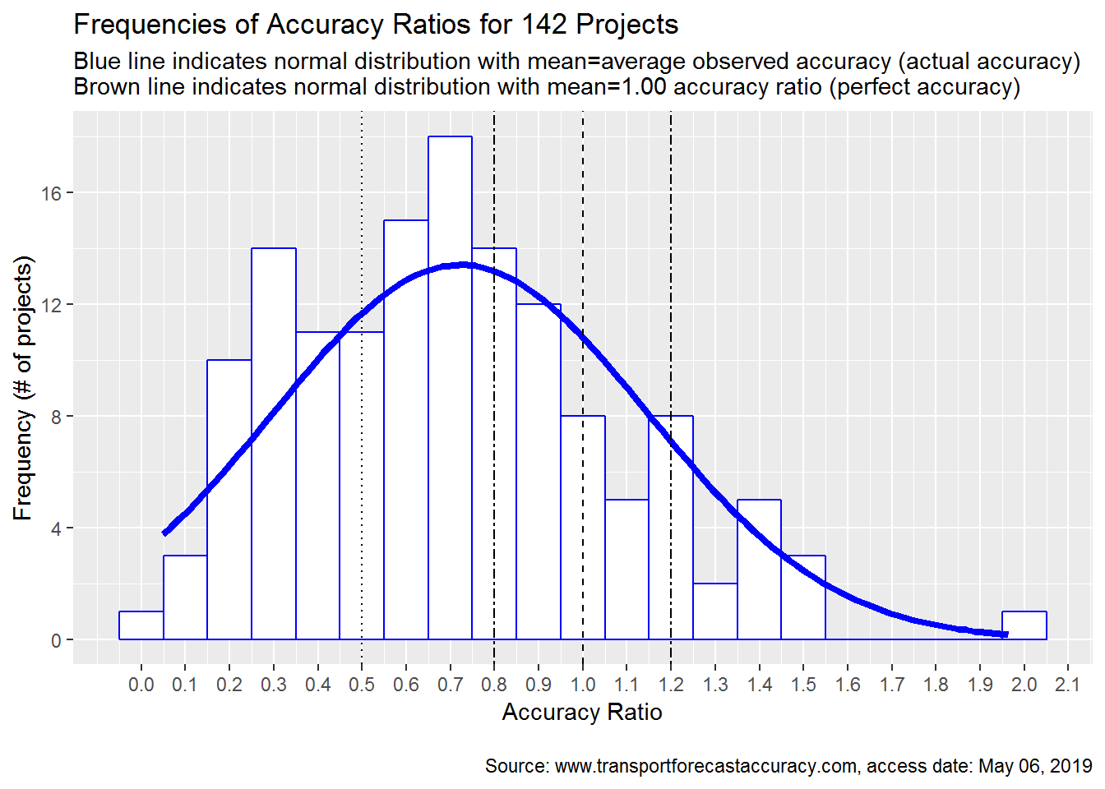
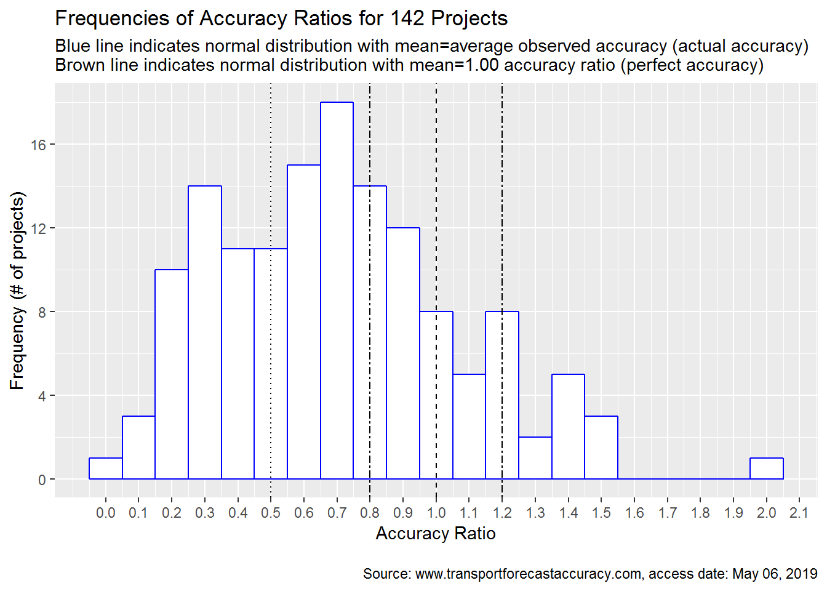
Overall Accuracy of Transit Forecasts
~1 in 3 projects … < 0.50
~1 in 3 projects … 0.50 – 0.80
~1 in 3 projects … 0.80 +
~1 in 6 projects … 1.00 +
Overall average ≈ 0.72
Notes:
...here is the distribution of accuracy for all 140 projects. (click) I've added a line that shows a normal distribution using the mean and standard deviation of all projects. As you can see many projects are to the left of the 1.0 line. I would point out the variability here - at least 8 projects have accuracy ranging from 0.2 to 1.2. There isn't a tight grouping around 1.0. (Click) To give a sense of the range of accuracy ratios, about 1 in 3 projects have actual ridership less than half of forecast, 1 in 3 projects have actual ridership greater than 80% of their forecast, with the other third of the projects in between. Overall about 1 in 6 projects have ridership exceeding their forecast. The average accuracy ratio for all 140 projects is 0.72, which is actual ridership 28% lower than the forecast value.

Slide 6
Analysis on Forecasting Accuracy
Are there statistically different levels of accuracy between modes? Are some modes harder to forecast accurately than others?
Are there statistically different levels of accuracy for projects that serve the area’s Central Business District (CBD) compared to those that do not?
Are there statistically different levels of accuracy for starter projects compared to expansion projects?
Are forecasts statistically more accurate in later stages of project development?
Are smaller projects statistically easier to predict than larger ones?
Generally, no
No
No
No
No, except when projected boardings > 30k
Notes:
I don't have time to show some of the analysis that tries to investigate if the accuracy ratio for certain projects is better or worse under different categories. So here is a listing of the results. Generally, when I look at accuracy ratios, I see very little difference in them across projects with different modes, locations, new mode vs. expansion projects, etc. Projects with a large number of boardings do have a statistically lower accuracy ratio than smaller projects.

Slide 7
Project Assumptions & Exogenous Forecasts
Provided to transit forecasters, and typically accepted without review
Accuracy of these assumptions are provided in some retrospective materials & summarized here
Examples:
Project characteristics (level of service, travel time, fare)
Transit system (supporting and competing networks)
Roadway system (level of congestion)
Demographics (population, employment estimates)
External conditions (economic, auto fuel prices)
Additional analysis indicates that input inaccuracy contributes to forecast inaccuracy
Notes:
I record the project assumptions and exogenous forecasts whenever the data was available. Exogenous forecasts are forecasts made outside the project. Population and employment projections are good examples. These forecasts and assumptions are important because (a) they typically drive the ridership forecast, and (b) the forecaster usually has to accept them without question or doesn't have time to review them. The accuracy of these forecasts and assumptions is not consistently reported at all. You'll notice that the most commonly reported item, the service levels which is the frequency or headway of the project, is only in 67 of the 140 projects. But the details I was able to gather indicate that they are generally optimistically biased themselves. (Click) I have done some additional analysis that I won't get into here, but simply state that the inaccuracy of these inputs does appear to contribute meaningfully to the ridership forecast.

Slide 8
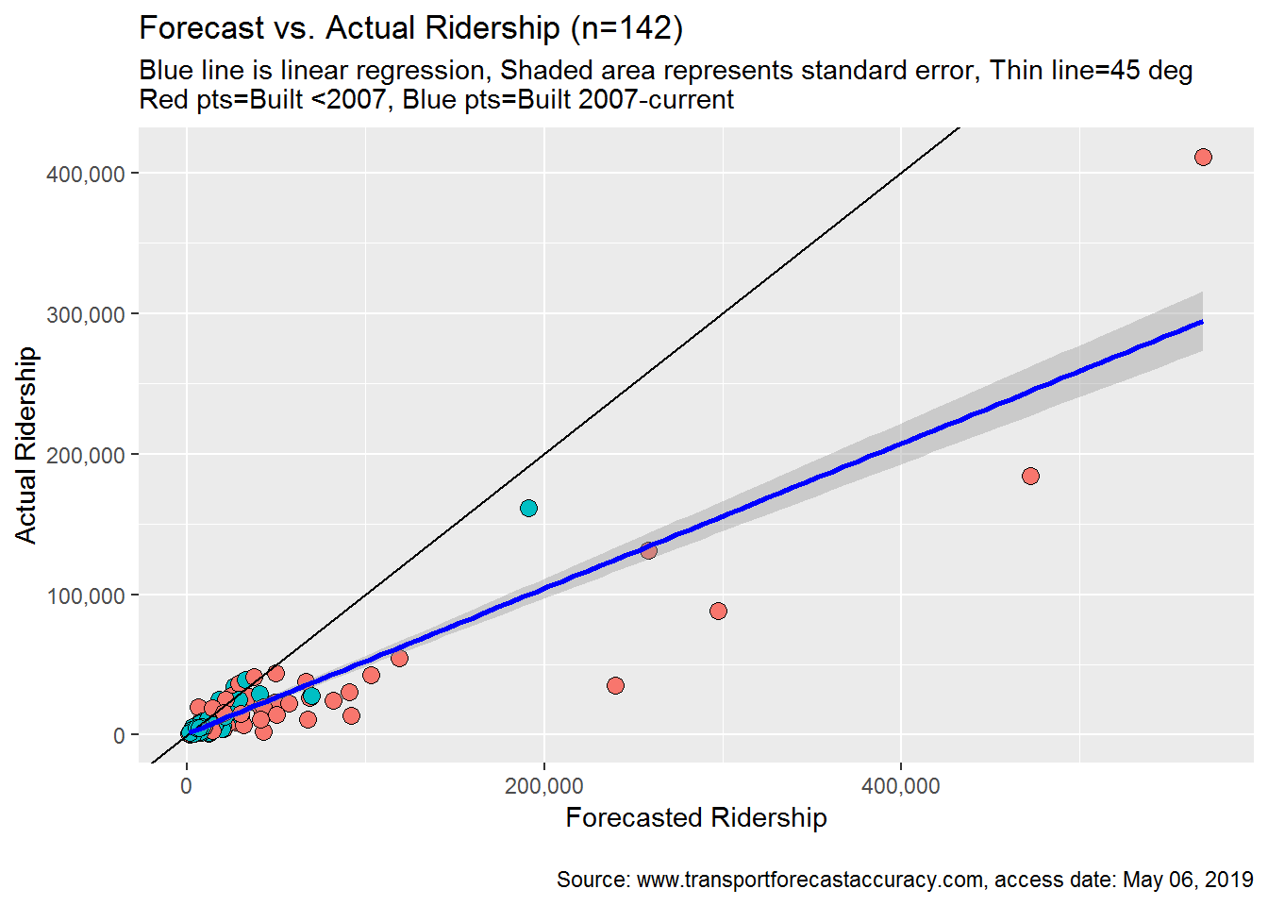
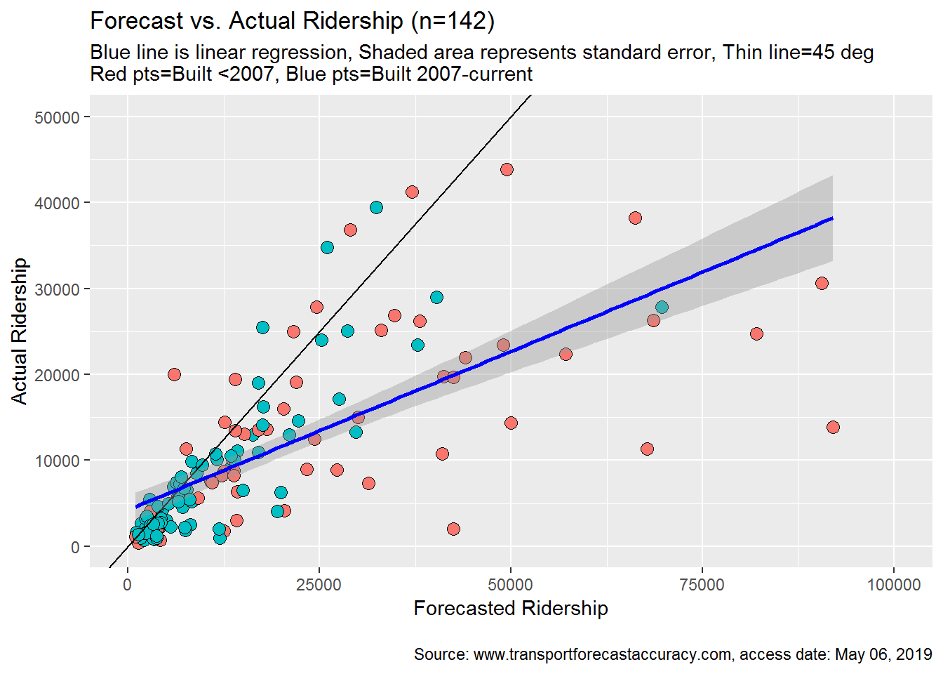
Has Accuracy Increased Over Time?
Subset of 140 project shown above
Notes:
A popular question is whether accuracy has improved over time, and I've tried to look at this a couple of ways. Here is a plot of the 140 projects...each dot is a project...red dots are projects built before 2007...blue dots are projects are built since 2007. Forecasted ridership is on the x-axis and actual ridership is shown on the y-axis. Dots above the 45-degree line have actual ridership higher than forecast...dots below the 45-degree line have actual ridership below the forecast. You can see some about 5 red dots below the line on the right-side dominating the chart. But it's a little hard to see with some of those projects, so I'll zoom in on it here (click). From this zoomed in view, you can see that the blue dots are much closer to the 45-degree line than the red dots. So this indicates that accuracy - in terms of the accuracy ratio - has gotten better since 2007.

Slide 9
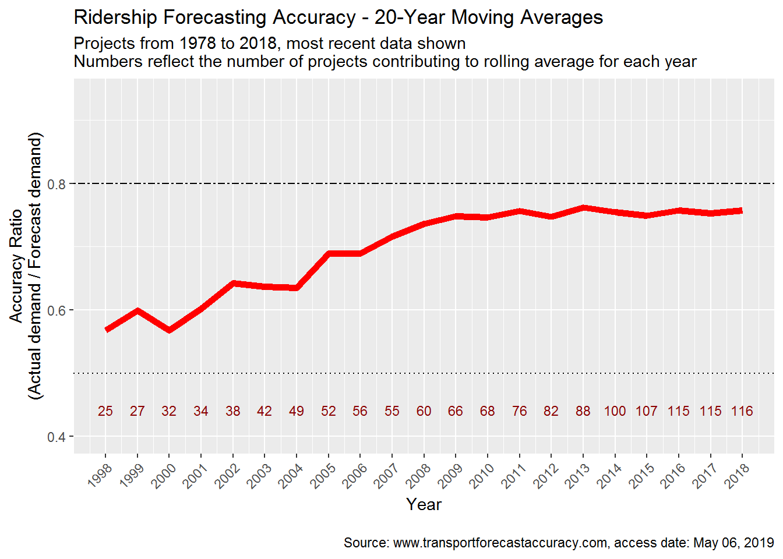
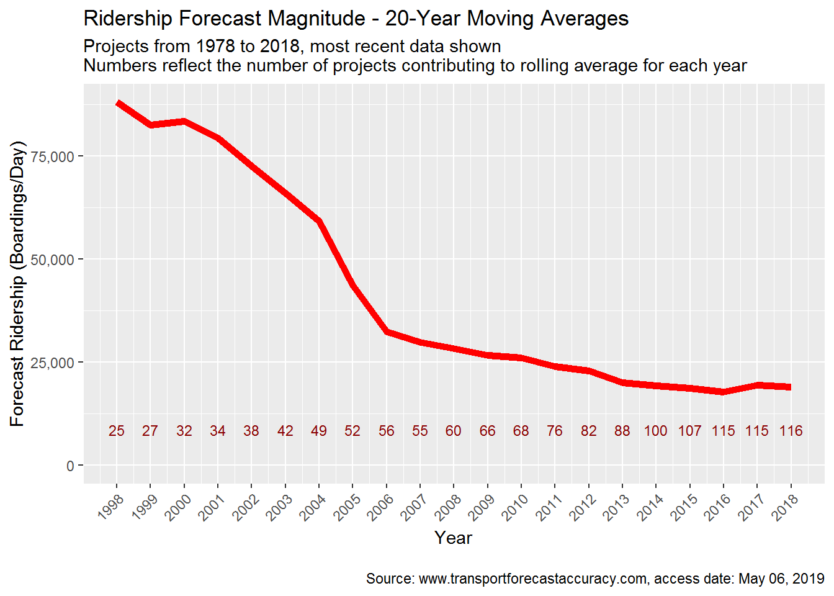
Has Accuracy Increased Over Time? (2)
Average accuracy generally better
Smaller projects → smaller error magnitude
Notes:
I also looked at the same question, but on a year-to-year basis. This chart shows the 20-year moving average. The accuracy ratio is on the y-axis. Each year shown on the x-axis. So in 2006, the average ratio is about 0.7...which is the average ratio of the 56 projects built from 1986-2006. You can see that average accuracy generally improves, but this in terms of accuracy ratio. (Click) During the same period the average size of the project, expressed in terms of forecasted ridership, dropped by over 1/3rd. So if the accuracy ratio generally improves, even slightly, and the forecast magnitude drops, then one would conclude that the error magnitude has dropped in recent years and... (go to next slide)

Slide 10
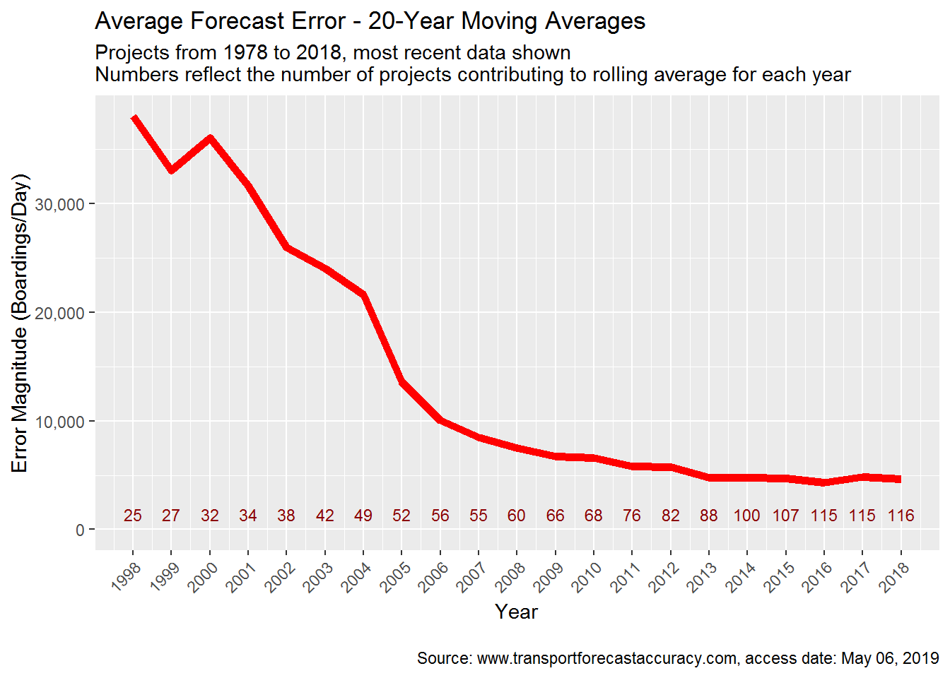
Has Accuracy Increased Over Time? (3)
Notes:
...That's exactly what this it shows when you put both charts together. Over time, the 20-year rolling error magnitude has dropped from nearly 40,000 boardings per day to about 5,000.

Slide 11
Personal Observations
Including all projects, forecast accuracy seems acceptable for capacity decisions, but optimistically biased for cost-benefit analysis
Inputs are a contributing cause of forecast inaccuracy
High degree of variability in forecast accuracy
Level of inaccuracy relatively similar across various project categorizations
Accuracy generally improving over time
Notes:
Here are some personal observations that summarize some key points you've seen. Thank you very much for listening to this presentation.

